Slide 1
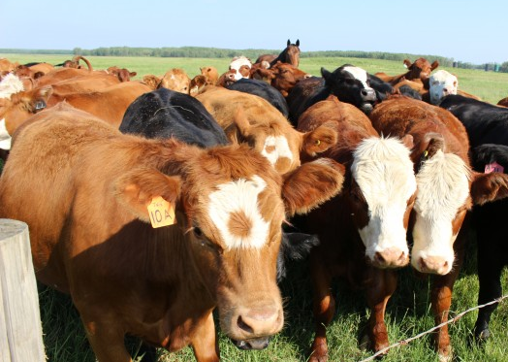
APHIS VS Center for Epidemiology and Animal Health

Slide 2

CEAH’s Vision:
To provide sound science for sound policy.
Notes:
So, this is our vision as an organization. We strive to be the voice of science in policy making.

Slide 3


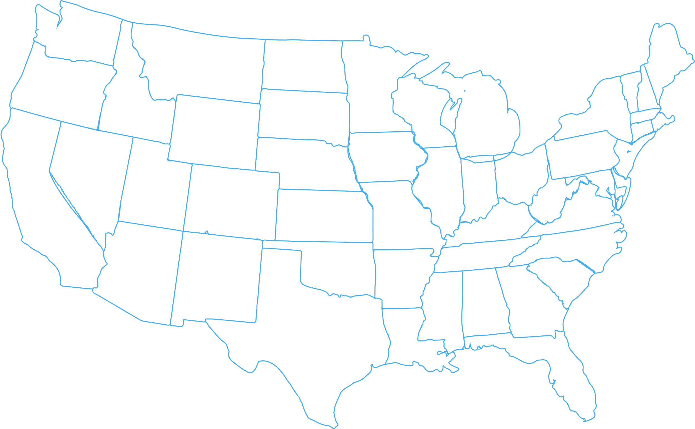




National Animal Health Monitoring System
(NAHMS)
Program Coordination and Implementation
(PCI)
Domestic Animal Health Analytics
(DAHA)
CEAH UNITS
Surveillance, Design and Analysis
(SDA)
Transboundary Disease Analytics
(TDA)
Geospatial Analysis, Products, and Services (GAPS)

Slide 4

Between Farm Disease Spread Models InterSpread Plus
FMD, ASF, CSF, HPAI, vND
National Scale
Domestic livestock only
Between farm transmission
Farms defined by production type, spatial point coordinates, and number of animals
Farm population simulated from Agricultural Census
Disease spread parameters defined at production type level
Flexible implementation of control measures
Applications include evaluation of disease response strategies and exercise support

Slide 5
Non-exhaustive List of Models Used By CEAH
USAMM/USDOS models (Colorado State University)
Feral swine disease spread model (APHIS Wildlife Services)
Bluetongue SE United States (Australian Animal Disease Spread Model, AADIS)
Wild/Domestic interface avian influenza model (University of Maryland USGS)
Remote Sensing of livestock facilities
TB Test and Remove model
Cattle fever tick situational awareness and control tools
Economic response cost and FAD economic impact models

Slide 6


Heterogenous Within Herd/Flock Disease Spread Model
Developed by University of Minnesota Secure Food Systems Team
Simulates animal to animal transmission within a barn
Direct within pen spread, pen to pen spread, and longer distance indirect spread
Current applications for HPAI and ASF
Evaluate surveillance schemes and pre-movement isolation period
Provides outputs for the between-herd national models
Estimate time of HPAI introduction for infected flocks
In progress application to cull sow markets
Window of likely introduction
Period of silent within-house disease spread and increasing infectivity

Slide 7
INFORMS Disease Spread Model
Developed through a cooperative agreement with the Texas A&M Center for Applied Technology
Designed around a web-based client/server approach
Operates in a cloud-based environment
Parallel/distributed execution of simulation runs
Testing and validation ongoing
Intend to deploy to USDA’s Azure environment

Slide 8
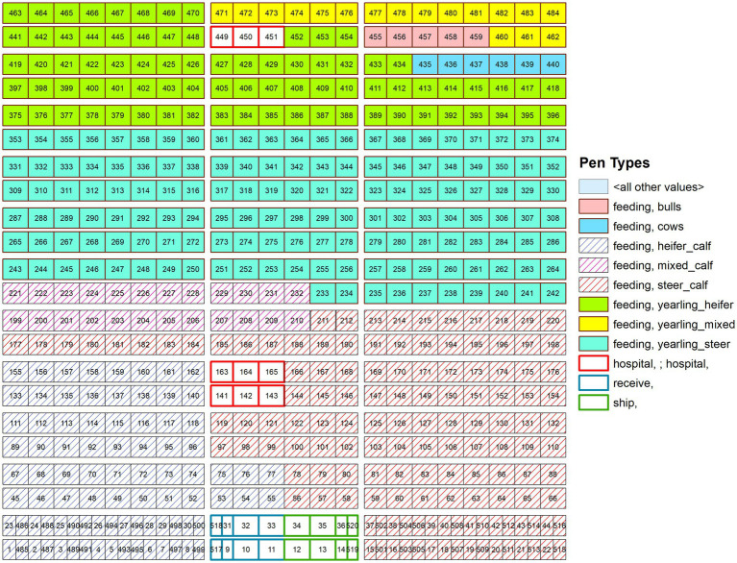
Current Collaboration with ARS
FMD model in a large feedlot
Interagency agreement has funded six ORISE Fellows
Translation of experimental data to FMD disease state parameters in cattle and pigs
Novel application of FMD control strategies in a large feedlot
Evaluation of FMD vaccination and persistently infected cattle
Evaluation of Control Area Sizes during ASF outbreaks
Estimation of lab demand during ASF outbreaks
Creation of a boar stud production type for risk assessment

Slide 9
Research Needs

